Slide 1
Air Pollution and Trees (but not the wooden type!): How Artificial Intelligence is Tackling Air Pollution
Liam Berrisford
Link To PoS Event:
https://pintofscience.co.uk/event/ai-mazing-technologies
Of Note:
All images generated with Midjourney
All text within the game generated with ChatGPT

Slide 2

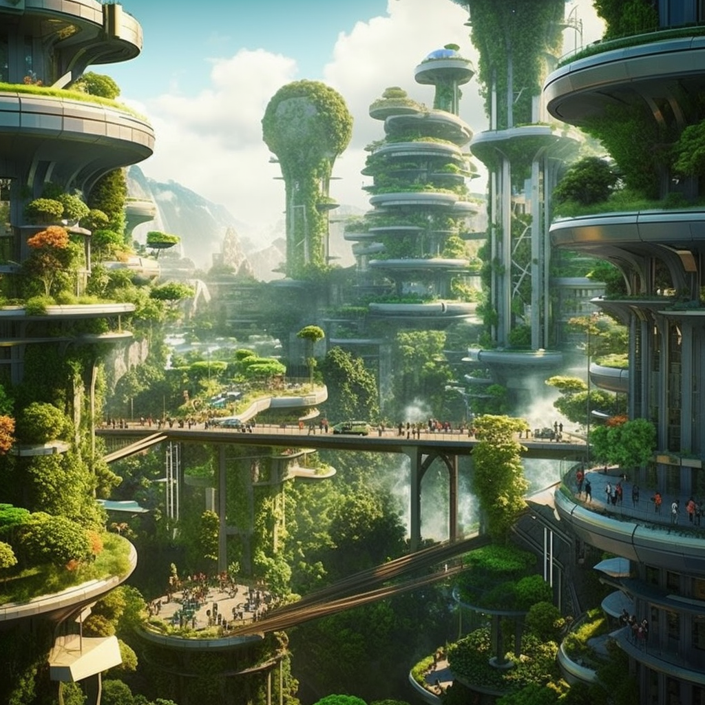
Which air pollution future are we building?

Slide 3
Which day of the week has the worst air quality?

Slide 4
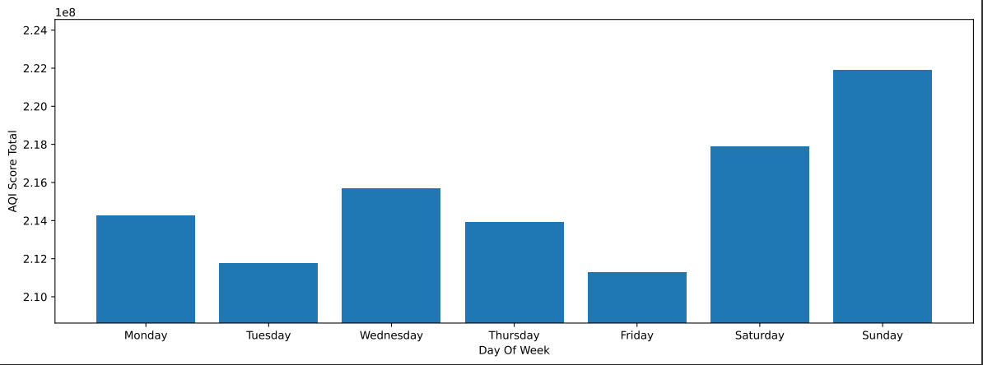
What day of the week has the worst air quality?

Slide 5
But why?
Driven by Ozone
The weekend effect!
Research found Urban stations were 12% higher on the weekends [2]
So what exactly are the air pollutants?

Slide 6
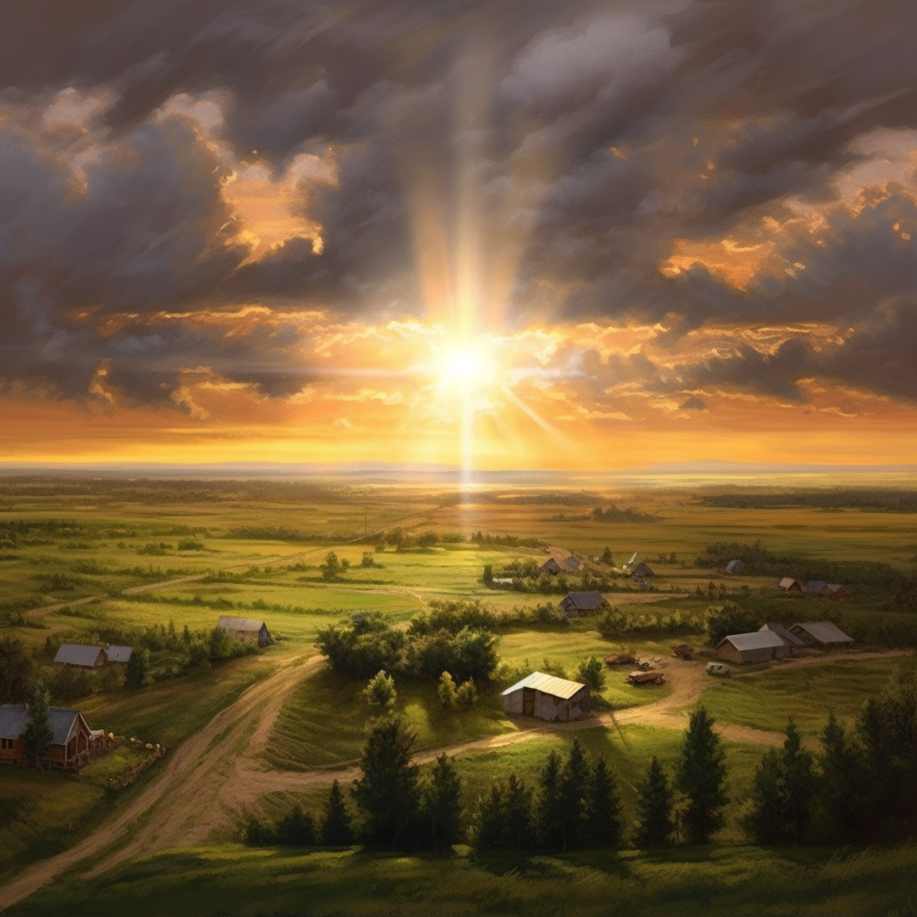
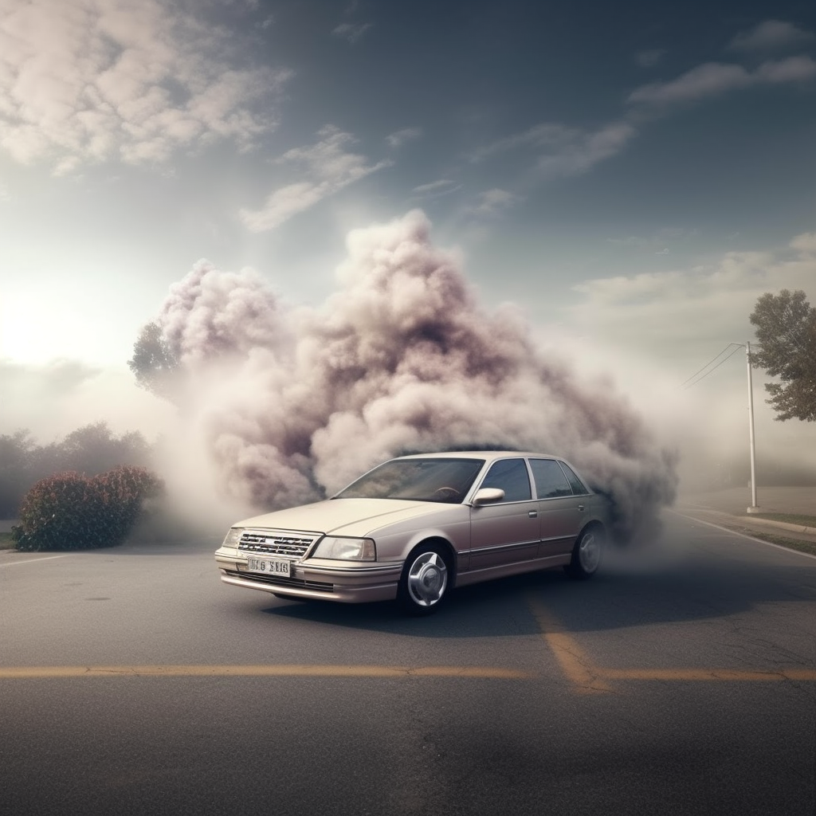
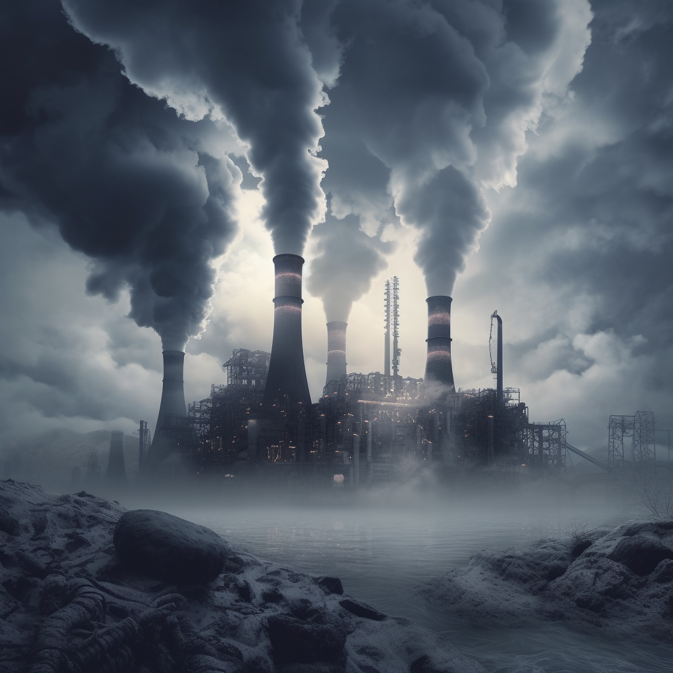

So what are the types of air pollution?
Ozone
Nitrogen Dioxide
Sulphur Dioxide
PM2.5 Particles
PM10 Particles
Sources
Irritation to eyes and nose, potential damage to airways
Inflammation of airways
Constriction of the airways
Impact
Respiratory and cardiovascular illness

Slide 7
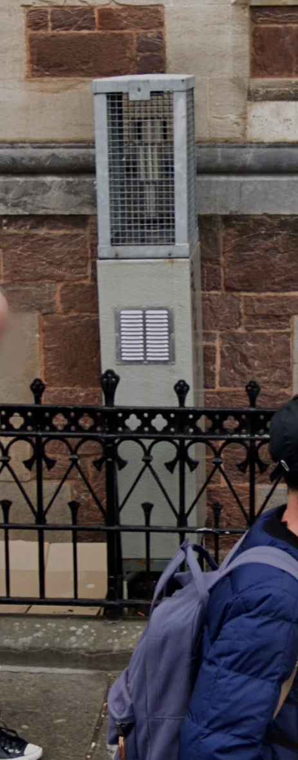
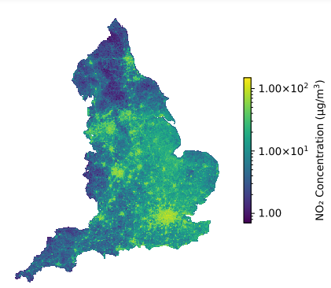
How can AI be used to tackle air pollution?
£198K per one, 171 across the country
355,827 “AI” stations across the country,
£70 Billion infrastructure value

Slide 8
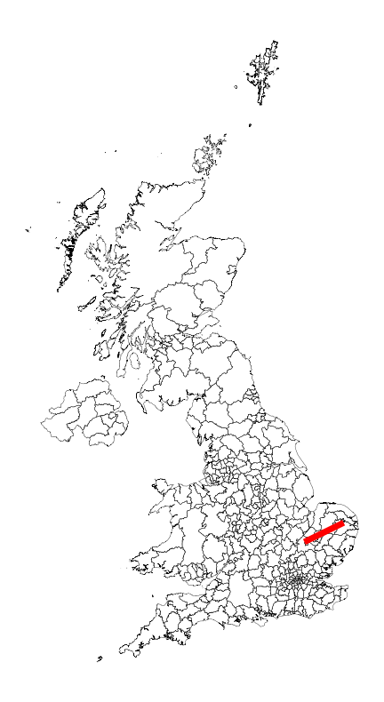
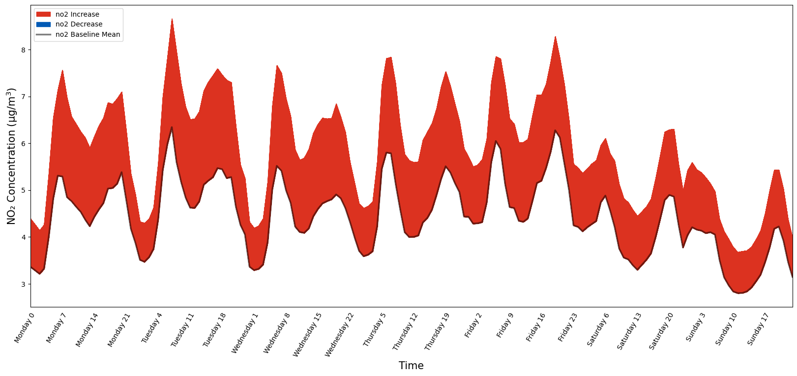
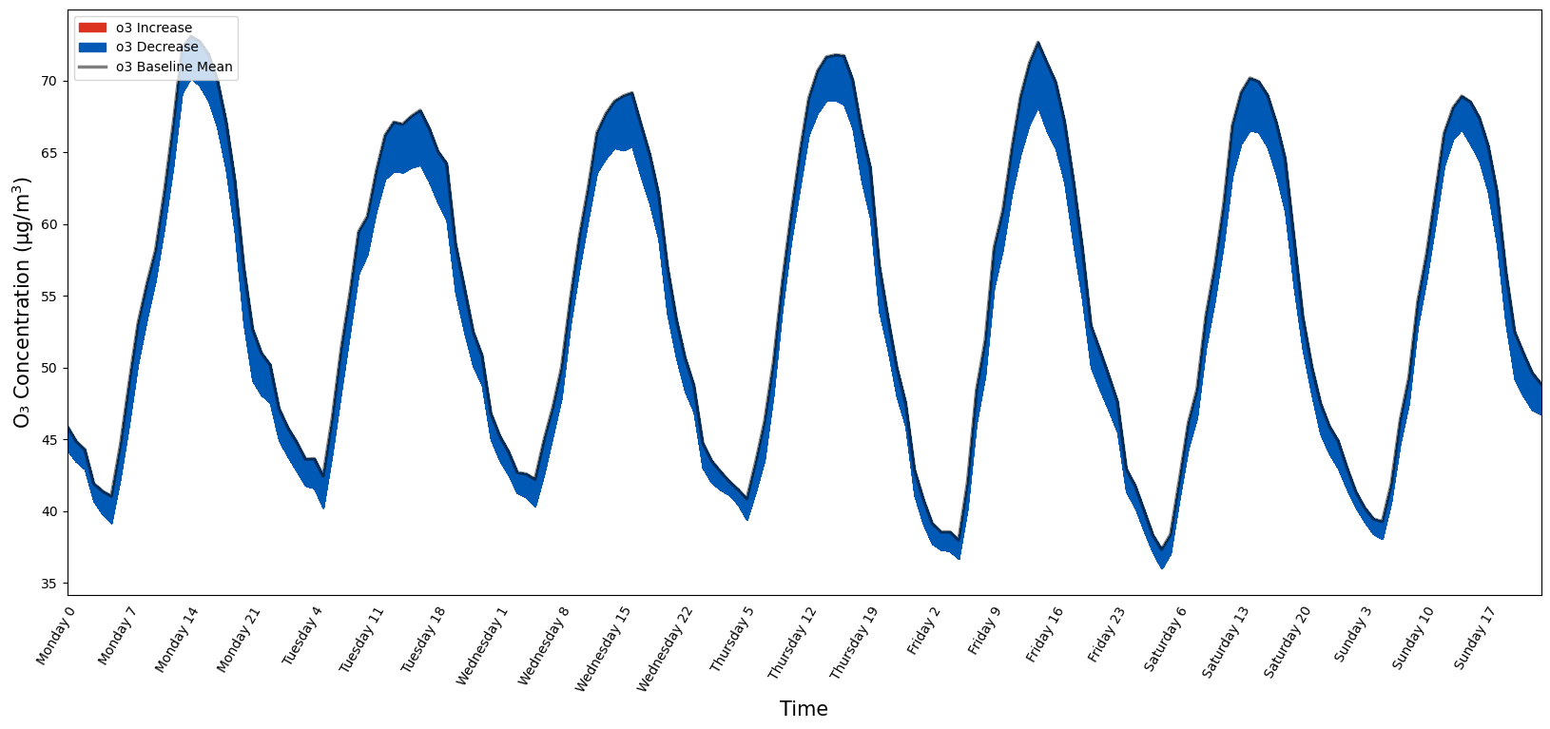
How can AI be used to tackle air pollution?
NO₂ Change
Proposed New Motorway Location
O₃ Change

Slide 9
What is a decision tree?
Is it raining?
Yes
No
Stay at home
Is it warm?
Yes
No
Go to the shop, don’t take a jacket
Go to the shop, take a jacket

Slide 10
Reading decisions
Decision Making
Decision One -> No, it is not raining
Decision Two -> No, it is not warm
Resulting Action -> Therefore I will go to the shop, and take a jacket
Is it raining?
Yes
No
Stay at home
Is it warm?
Yes
No
Go to the shop, don’t take a jacket
Go to the shop, take a jacket

Slide 11
Reading decisions
Is it raining?
Decision Making
Decision One -> Yes, it is raining
Resulting Action -> Stay at home
Yes
No
Stay at home
Is it warm?
Yes
No
Go to the shop, don’t take a jacket
Go to the shop, take a jacket

Slide 12
Building your own pollution predicting decision tree!
ROAD USAGE
HIGH
Variable
MEDIUM
Variable
LOW
Variable
High Pollution
Medium Pollution
Low Pollution

Slide 13
Building your own pollution predicting decision tree!
ROAD USAGE
MEDIUM
Variable
LOW
Variable
HIGH
Variable
Medium Pollution
Low Pollution
WIND
HIGH
Variable
MEDIUM
Variable
LOW
Variable
?
?
?

Slide 14
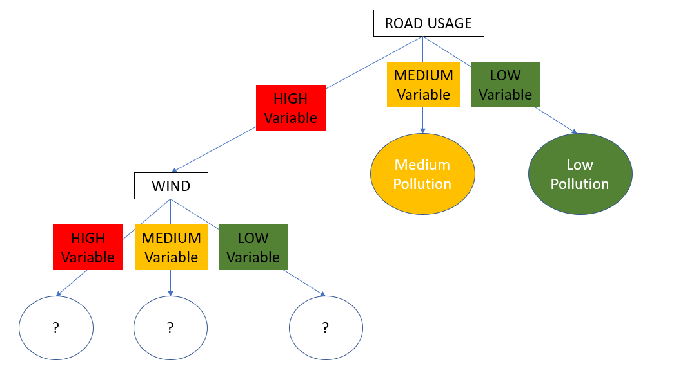
Game Setup
Build the tree however you want, but ensure consistency!
If you want to build your own cards write on the back of the laminated card!
Nodes
High Pollution
Circles represent outcomes
HIGH
Variable
Coloured squares represent measurements
WIND
White represent simple measurements
SUBURBAN
Grey represent complex measurements

Slide 15
References
[1] https://engineering.berkeley.edu/news/2009/03/the-ozone-weekend-effect/
[2] https://www.sciencedirect.com/science/article/pii/S0013935120310902

